Slide 1

Let’s talk about…Being LGBTQ+ in Trinity & Dublin
Dr Jason Keegan (he/him)
Pride in Research
Sam Flynn
Inclusions Officer, Q Soc
Amy Kennedy (sí/í)
AMLCT/TCDSU
Martin McAndrew (he/him)
Postgraduate Advisory Service
Information session

Slide 2

Today’s information session
Pride in Research – scholarship by and for LGBTQ+ communities
Q Soc – finding your community in Trinity & Dublin
TCDSU – activism and fighting for a fairer future
Postgraduate Advisory Service – supports, services, and staying in touch

Slide 3
Other helpful orientation sessions:
Let’s talk about… Equality, Diversity and Inclusion (recording now available on the timetable website)
Positive sexual experiences
Thursday 2pm, JM Synge Theatre
Living and dating in Dublin
Thursday 3pm, Ed Burke Theatre

Slide 4

Background
Trinity has been at the fore of LGBTQ+ activism since the early 1970s
Discrimination on Gender Identity or Sexual Orientation grounds is illegal in Ireland
2015: Marriage Equality Referendum and Gender Recognition Act
Policies in Trinity which support and protect LGBTQ+ students and staff:
Gender Identity & Expression
Equality
Dignity & Respect (bullying, harassment)
Sexual Misconduct

Slide 5

Dr Jason Keegan (he/him)
Volunteer-led initiative to support LGBTQ+ researchers at any level
Annual National Conference held during pride month in TCD
Aiming to run a student centred mini-conference during term time this year
Notes:
I’m Jason Keegan and I’m a Post-doc in the Zoology Department
I’m one of the organisers of Pride in Research. To date Pride in Research is an academic conference, held every year during Pride Month in TCD.
It is designed as an event for LGBTQ+ researchers or allies conducting research relevant to the LGBTQ+ community.
It’s a celebration of the wide variety of research being conducted by LGBTQ+ people in TCD an other universities. We also aim to create a community of support.

Slide 6

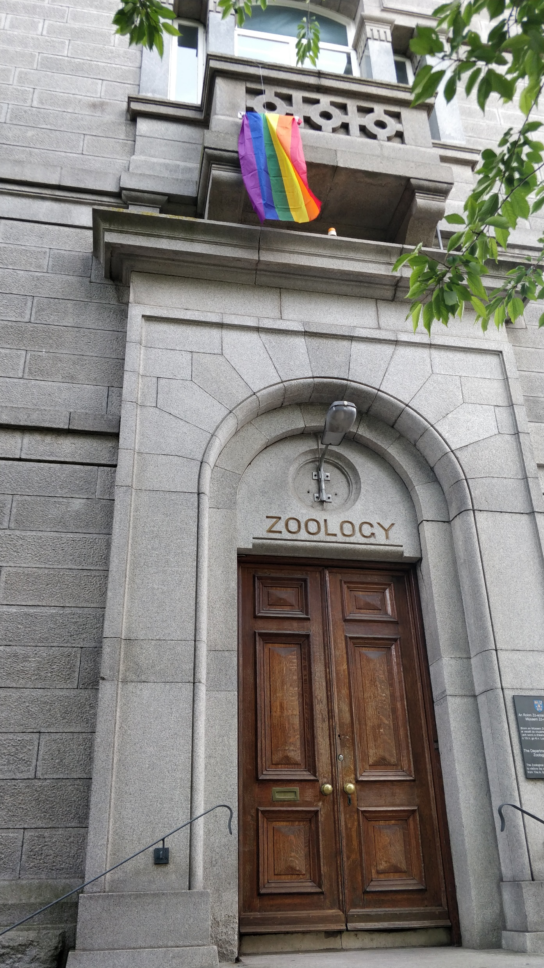
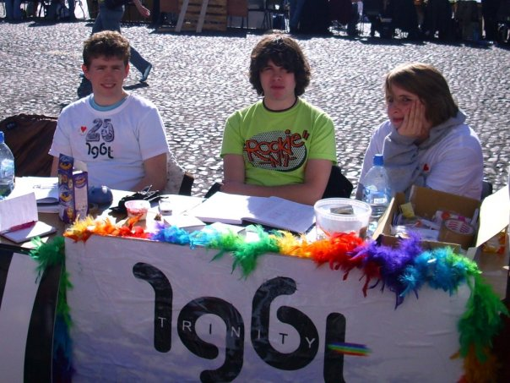
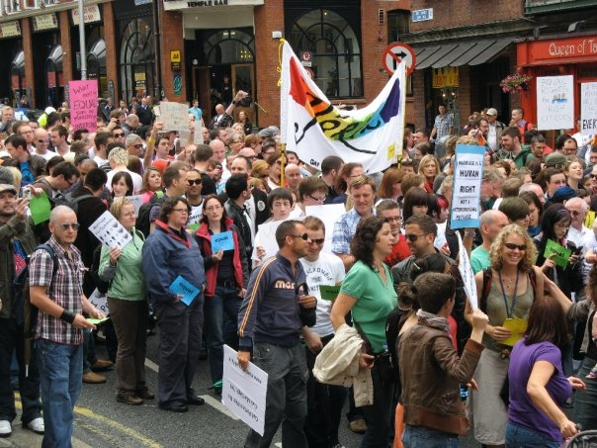
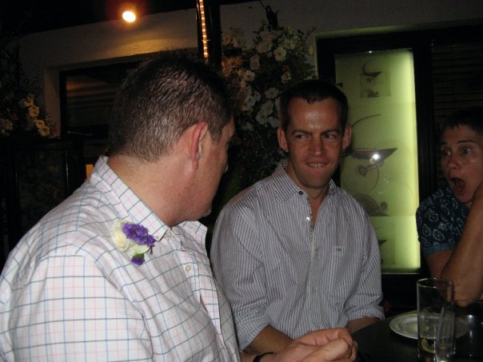
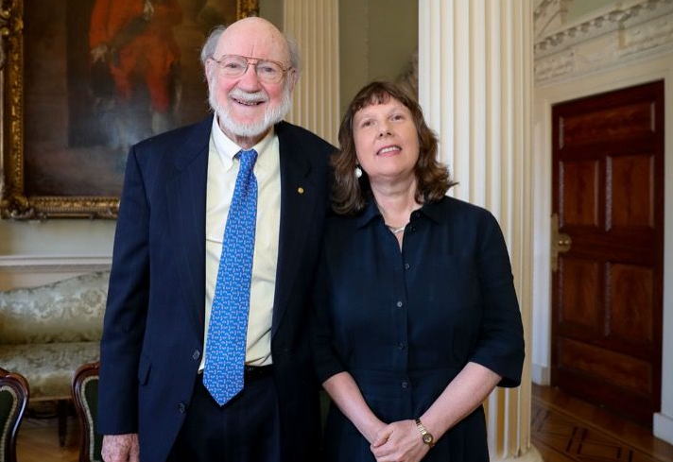
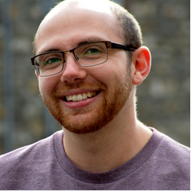
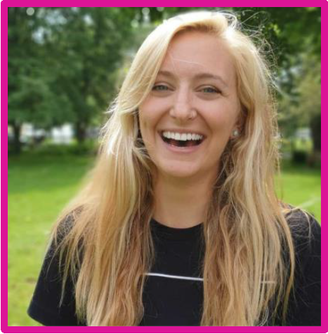
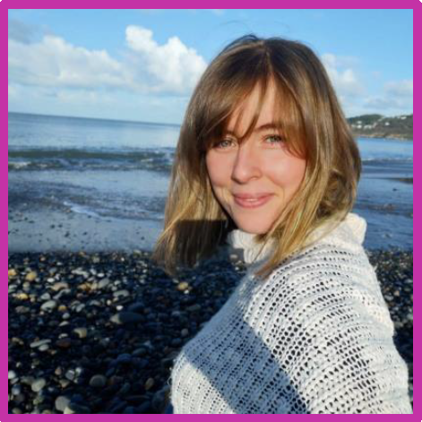
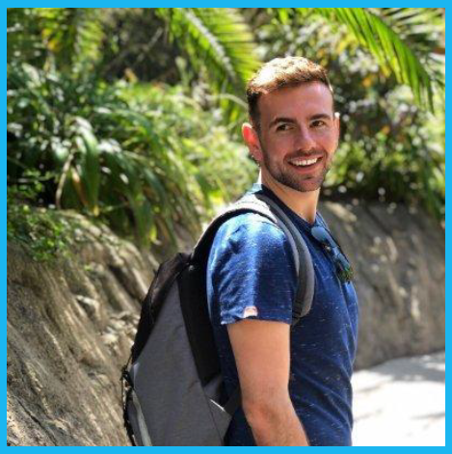
Notes:
Colllege - LGBT society, First boyfriend, both did zoology in third year, had wonderful gay role models and wonderful allies. I had been working on building sites every summer before zoology and to enter a work place that was so proud of its queer staff and students was transformative.

Slide 7

Pride in Research over the years
The Information Worlds of the NonBinary and Genderqueer Community in Ireland
Finding whiffs of volcanic eruptions in peat bogs
Telenovelas and attitudes toward the LGBTQ+ community in Latin America
Gaining or losing ground? Access to sexual and reproductive care across Europe
Are the parasitic worms of dogs and cats lurking in my garden?
Queer Joy as a Digital Good: Social Media as a Vehicle for Queer Joy

Slide 8
Pride in Research over the years
Searching for proteins as biosignatures of extra-terrestrial life for planetary missions
Queer space, visibility, and the built environment: The Hirschfeld Centre and the Don Wood photographic collection 1980-83
Stability of aromatic ketoacids and their inflammatory role during trypanosomiasis
Non-binary Lesbians: How Identity based on Inclusion helps Lesbiansim to Survive
Goat-ing The Whole Story: Exploring The Domestication Of Goats Through Paleogenomics
Catholic Schooling and Sexual Identity Development

Slide 9
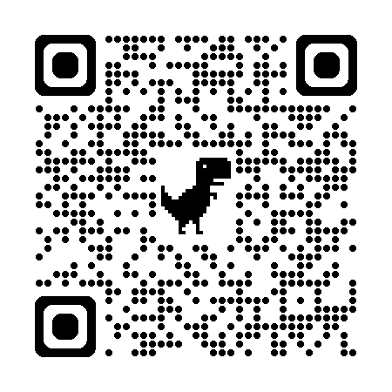
Want to get involved?
Get in touch at prideinresearch@gmail.com
Follow us for updates on our next events
https://www.instagram.com/prideinresearch/

Slide 10

Q Soc-led supports
(Sam Flynn)
Q Soc is the Oldest LGBT+ Society in Ireland and a well-established resource for queer students at Trinity College Dublin.
Joining!!
The Societies Hub website has a signup page for QSoc!
Signups will also be available at the Fresher’s Week stand
We will have events on from the beginning of the semester onwards!

Slide 11

Closed Spaces
A Closed Space is a closed group of people discussing a particular orientation.
It is “Closed” in that only people of that orientation, or questioning, can come.
Very good to discuss experiences, relate to other students who have gone down the same path as you.
Previous Closed Space formats, MLM, WLW, Bi+, Trans & NB, Aro-ace, International Students, Ethnic Minorities and more!
Notes:
11

Slide 12

QSoc Points of Contact
If you have a general query, DM us on Instagram at @q_soc or email us at lgbisoc@csc.tcd.ie! We try to respond to every message within a few days. If you’d like a member of our committee to meet you before an event, do contact us here.
Inclusions Officer: (That’s me!)
If you want a more personal chat or guidance in how to get included with QSoc, you can reach out to our Inclusions Officer at qsocinclusions@csc.tcd.ie
Notes:
12

Slide 13

Coffee Hours!!
QSoc runs daily coffee hours from 13:00-15:00pm
Look out for our postgrad coffee hour at some point during term!
Notes:
13

Slide 14

TCDSU/AMLCT
Your union has a wide array of supports and services available to you
Amy Kennedy

Slide 15
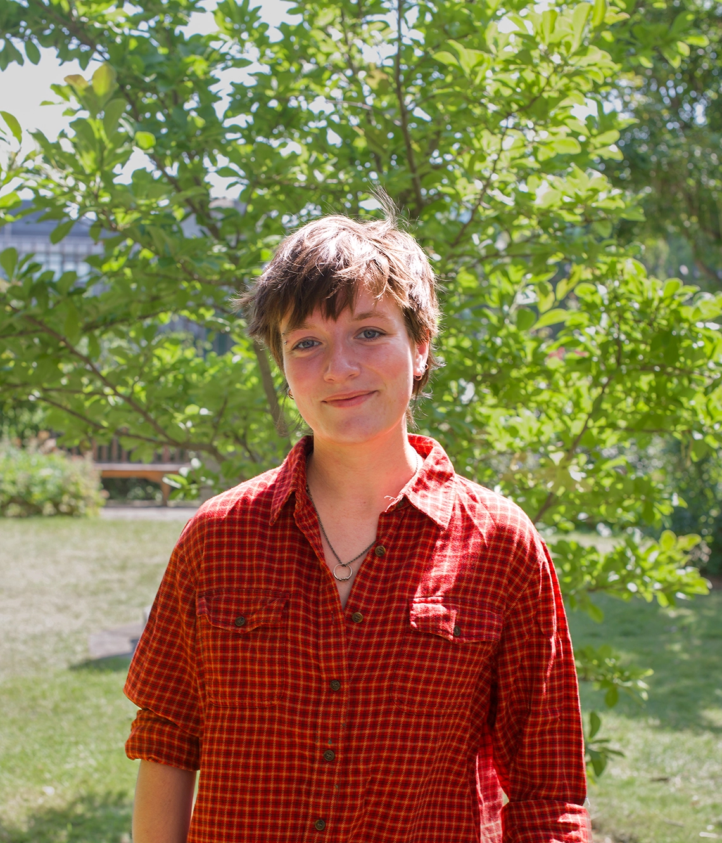
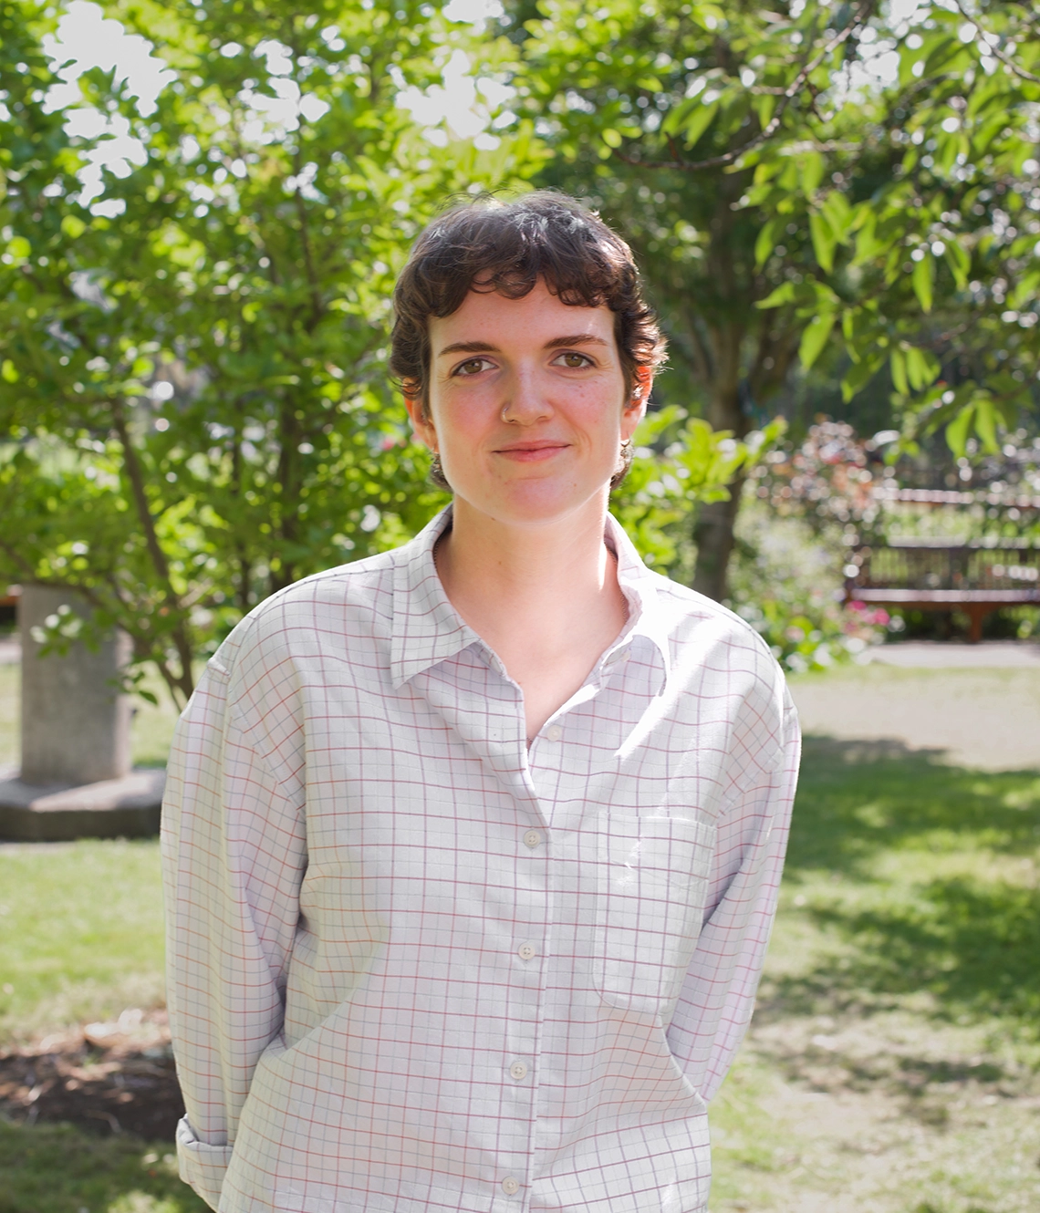
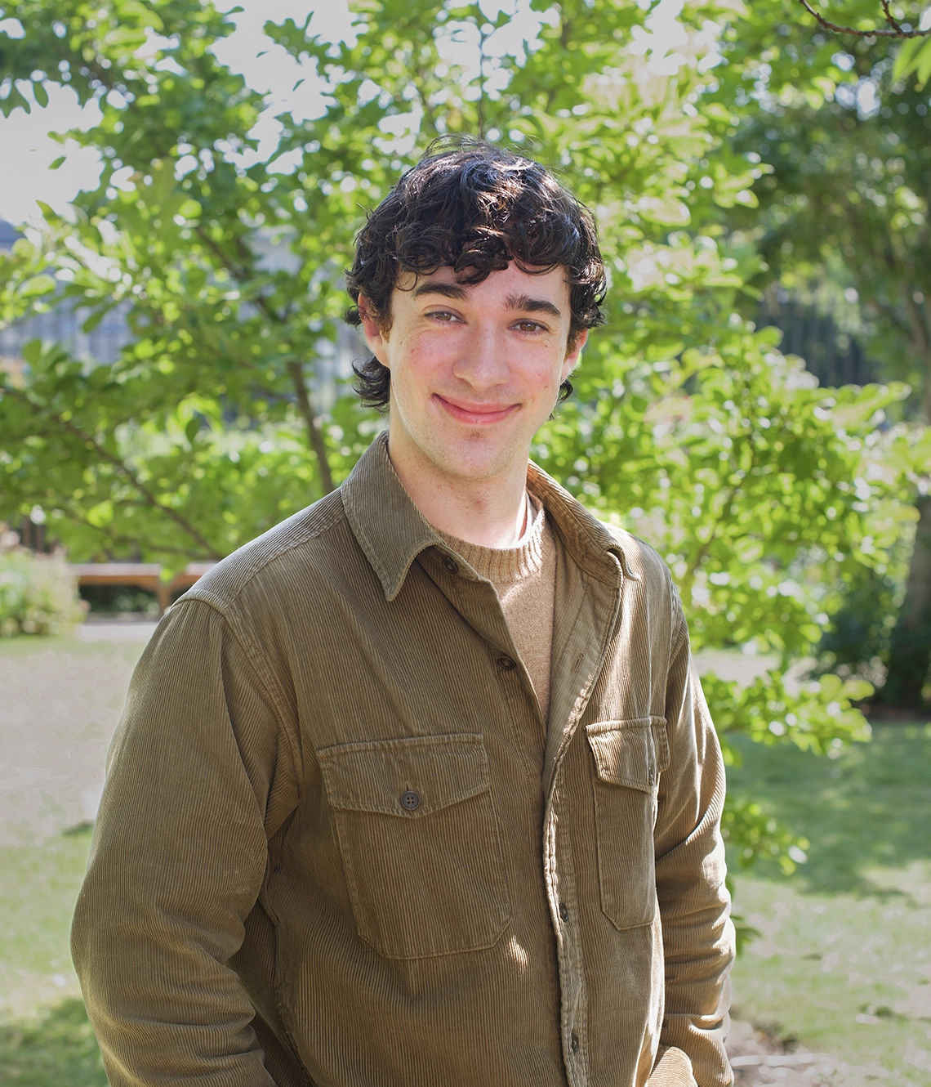

TCDSU/AMLCT
Amy Kennedy (sí/í)
President
president@tcdsu.org
Ava Tuohy (she/he)
Graduate Officer
graduate@tcdsu.org
Lorenzo Cheasty (he/him)
Welfare & Equality Officer
welfare@tcdsu.org
Sophie Coonan (she/her)
LGBT+ Rights Officer –
part-time, voluntary
lgbt@tcdsu.org

Slide 16
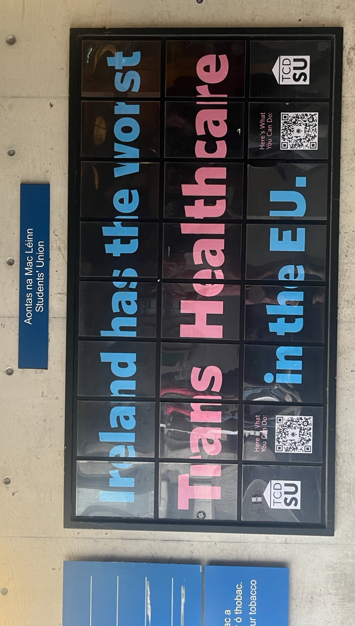
…But how can I help?
Get involved in Union campaigns!
Campaigns Town Halls held and advertised throughout the year, this town hall is usually held in a class room and online. It is an open forum for any student to throw in their two cents on what way they think the union can achieve its goals. First one is next Tuesday to work on strategy for Palestinian Student Visas.
Campaigning can take so many forms.
  The best campaigns are when you aren’t trying to be what you think a campaign is.
  You can play to your strengths, join the campaign groupchat or the campaigns committee at the first Comhairle meeting to get involved.
Become a class rep!
  Every student is entitled to run and to vote!
  If you are a Postgraduate Researcher you can represent your year for your school.

Slide 17
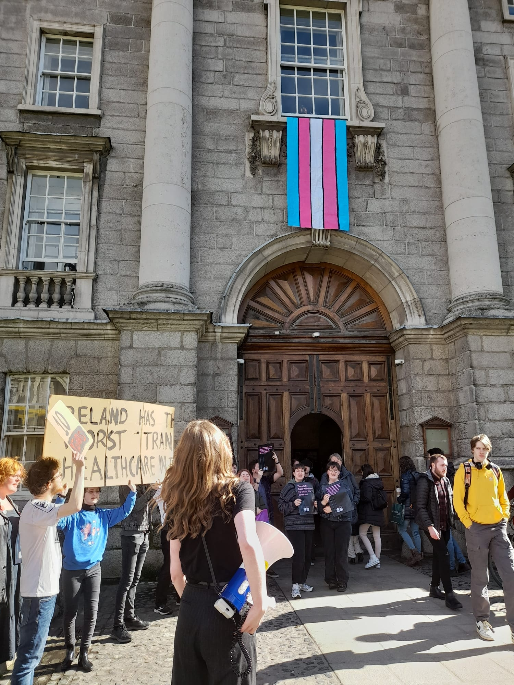
TCDSU/AMLCT
Campaigns WhatsApp group chat

Slide 18
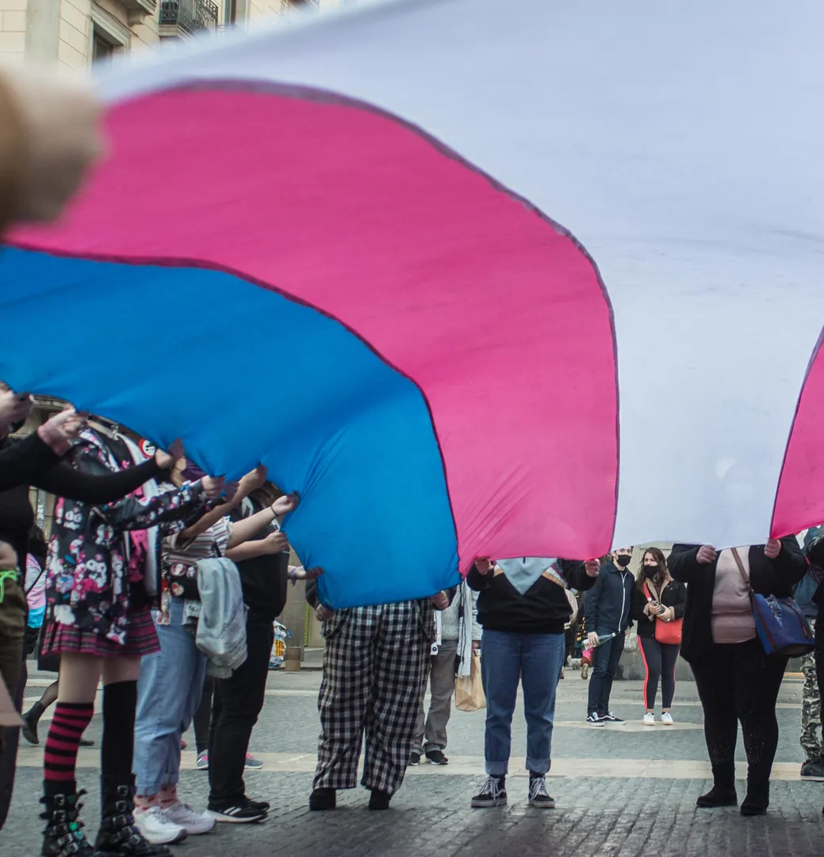
The T Fund – a student-run service
Students are able to apply for gender affirming items such as binders, gaffs, makeup, clothes, etc.
The T Fund committee meets once every term to allocate money to the applicants
Cannot be used for medical supplies
There is €1000 for each term, and a limit of €200 per student.
If you feel this resource would be useful to you, please keep an eye out on the weekly SU email for applications

Slide 19

Queer Spaces in Dublin
Bars & Clubs
Sport
Alcohol Free
The George on Dame Street is a great shout. It is very fun, it has a lot of straight people with their one gay friend, but the vibe is usually good.
Pantibar on the Northside of the River is a more laid back space. Music is more of a factor, the kind of bar you go to meet people to talk to.
Street 66 is an amazing Queer pub that hosts regular daytime and nighttime events. Great spot to watch matches, play board games, and chat with weekly dancing as well.
Pennylane next to Pantibar is a relaxed bar. Good cocktails. Age range skews a little older
Emerald Warriors LGBT+ Rugby team
Stoneballerz: LGBTQ+ Softball
Na Gaeil Aeracha GAA Football (men’s & women’s) and Hurling
Dublin Devils LGBTQ Football (broadly mens) (soccer)
Pink Ladies LGBTQ+ Hockey
Shamrock Síoga LGBTQ+ Basketball
Out and About Queer Hiking
Group. (Age range skews a bit older)
Dublin Front Runners: LGBT Running Group
Outhouse LGBTQ+ Resource and community centre
Small Trans Library: Book Clubs and Screenings
Black Queer Book Club: Reading Groups
Outhouse Cafe: Coffee Mornings, events
Queer Alcoholics Anonymous
Dublin FLINTA* Community: Book clubs, hiking

Slide 20
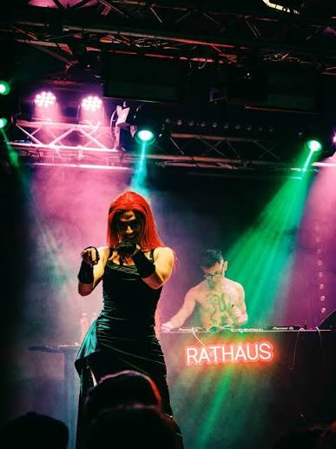

Queer Spaces in Dublin
Club Nights
Venues
Festivals
Honeypot: Queer, Lesbian, and Trans night.
Mother: Gay club night, most Saturdays at Lost Lane on Grafton Street, usually more men
Rathaus: Berlin inspired queer club night, once a month (ish), techno and pop
Dykon: Lesbian club night
King: Queer, Lesbian and Trans night, run by the same group as Mother
Sweatbox: Gay club night, generally aimed at men
Aphrodisiac: Queer POC Nights, generally lesbian focused
Sin É: music venue and pub on the Quays, good punk gigs, lesbian line dancing
Daylight Glasnevin: mix of gigs, craft events, nights out
Trans Image Trans Experience (TITE) Film Festival: runs in the Lighthouse Cinema in Smithfield, focus on championing trans and nonbinary filmmakers
Gaze Film Festival: run across the Irish Film Institute in Temple Bar and the Lighthouse Cinema in Smithfield
Dublin Gay Theatre Festival (a.k.a. Wilde Stages): runs across theatres and venues in the city, takes place in the first two weeks of May

Slide 21
Safe Practices in Dublin
Dublin is rather safe for Queer students. Common sense is the main consideration.
On a night out:
-- Make sure you know how you’re getting home before you go out, have a plan, don’t plan to walk home at 4 am alone.
-- If you’re going to a stranger’s house, make sure to let someone know, send the address and make sure they know when to check in if you haven’t messaged again.
-- Don’t do anything if your gut tells you isn’t safe.
Safer Sex:
-- Both the SU and QSoc keep free Condoms,
Dental Dams and Lube handy if you need
any– don’t hesitate!
-- College Health also does confidential STI
tests for students
-- There are a number of national resources
for free HIV testing, at-home STI testing, and
PrEP

Slide 22
Safe Practices in Dublin
While Dublin doesn’t have the biggest drug scene compared to other European Cities, all Drug safety tips still apply:
Drug safety
-- Don’t take something if you don’t know what it is.
-- Don’t take something for the first time when you’re out.
-- Be aware of common signs of spiking in drinks:
- Drink looks foggier with excessive
bubbles & ice doesn’t float
- Change in taste or colour
- Unexpected intoxication or
breathing issues
Needle Spiking:
While rare, be aware of needle spiking!
People now spike using needles
If you suspect needle spiking:
- Bleed the puncture by squeezing around it
- Wash with soap under warm water
- Cover with dressing if possible
-Report ASAP and seek medical help

Slide 23
Supports and Services for LGBTQ+
Martin McAndrew (he/him)

Slide 24

Updating your student record
If your name or gender identity is different to that
on your student record:
You do have a gender recognition cert/ supporting documentation:
Fill in the Change of Details from
Bring form, documents and your student ID card to Academic Registry
You don’t have a gender recognition cert/ supporting documentation:
Fill in the change of details from
Book an appointment with PAS
PAS will co-sign the change of details form
Bring form, documents and your student ID card to Academic Registry

Slide 25
Updating your student record
Change of name/ gender support session
Academic Registry, Senior Tutor’s Office and Postgraduate Advisory Service will host an information session on changing your details
Will be an opportunity to complete and submit the form that day, or take them away with you to submit later
Date and details tbc

Slide 26

Supports for LGBTQ+ students at Trinity, if you:
Need a place to talk through stuff, get support:
Student Counselling Service is fiercely allied with the Queer Community.
Need a space to talk intersectionally:
Queer Disabled Peer group: Facilitated by staff and students. Meets every 2 weeks during term. Dates tbc
Need advice on healthcare:
College Health
(Sexual health clinic and PrEP clinic)
Experience bullying, harassment, assault
Dignity Respect & Consent team
Need clarity on equality matters in Trinity:
EDI Office: equality@tcd.ie
Need free legal advice:
Trinity FLAC clinics

Slide 27

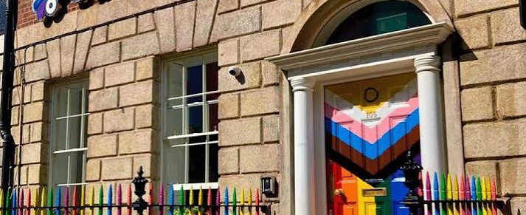
Outhouse: Dublin’s LGBTQ+ Centre
Café
Library
Garda clinics, STI testing
Information on legal/ advisory services
Information on health and wellbeing
Personal development
Coming out support
Activism and a community hub

Slide 28






Outhouse: Dublin’s LGBTQ+ Centre
Social groups and facilitated peer support
Confidential, free
All are welcome!

Slide 29
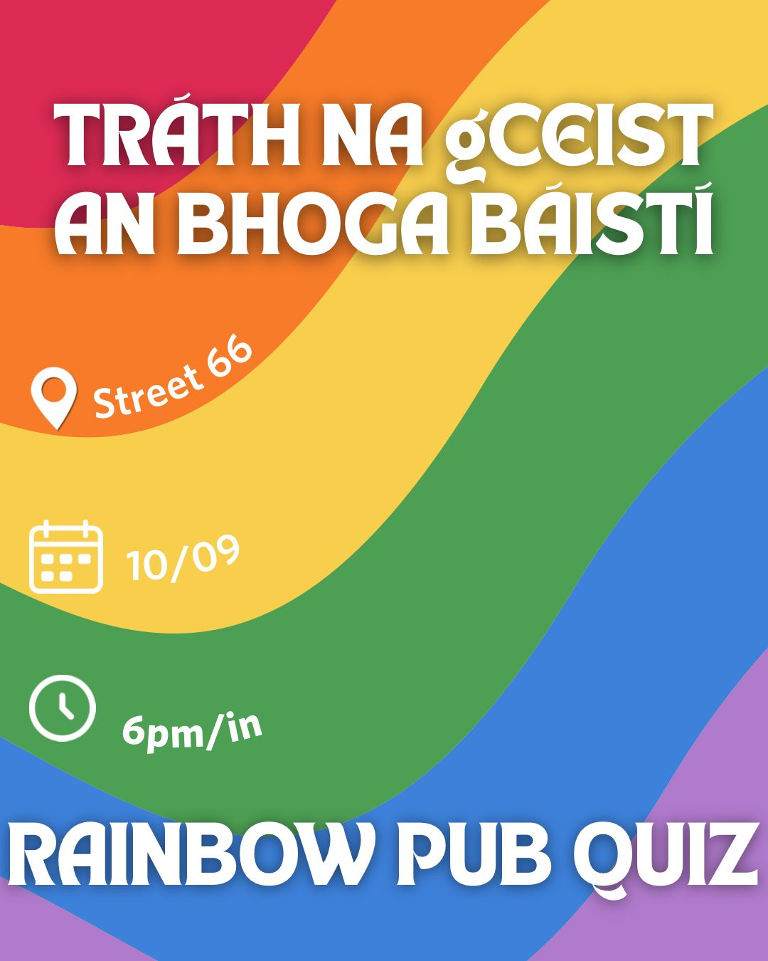

LGBTQ+ Postgrad
Rainbow Table Quiz tonight
6-8pm
Street 66 – Parliament Street
If you missed out on a ticket, please join us after 8pm!

Slide 30
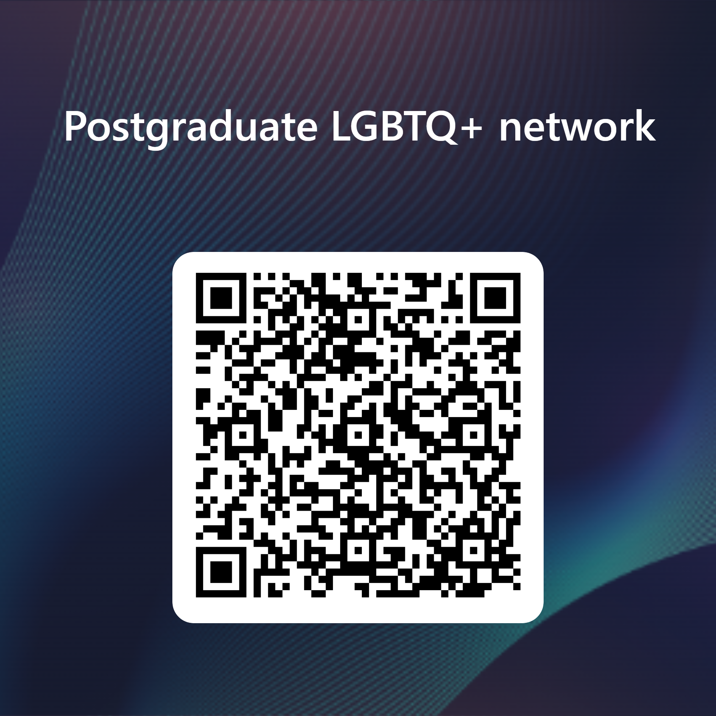
Finally… let’s stay in touch!
An opportunity for LGBTQ+/ Queer postgraduates to connect, remain up to date on events, initiatives, and resources available in College and externally
To join a mailing list for updates, add your contact information to the form here:

Slide 31
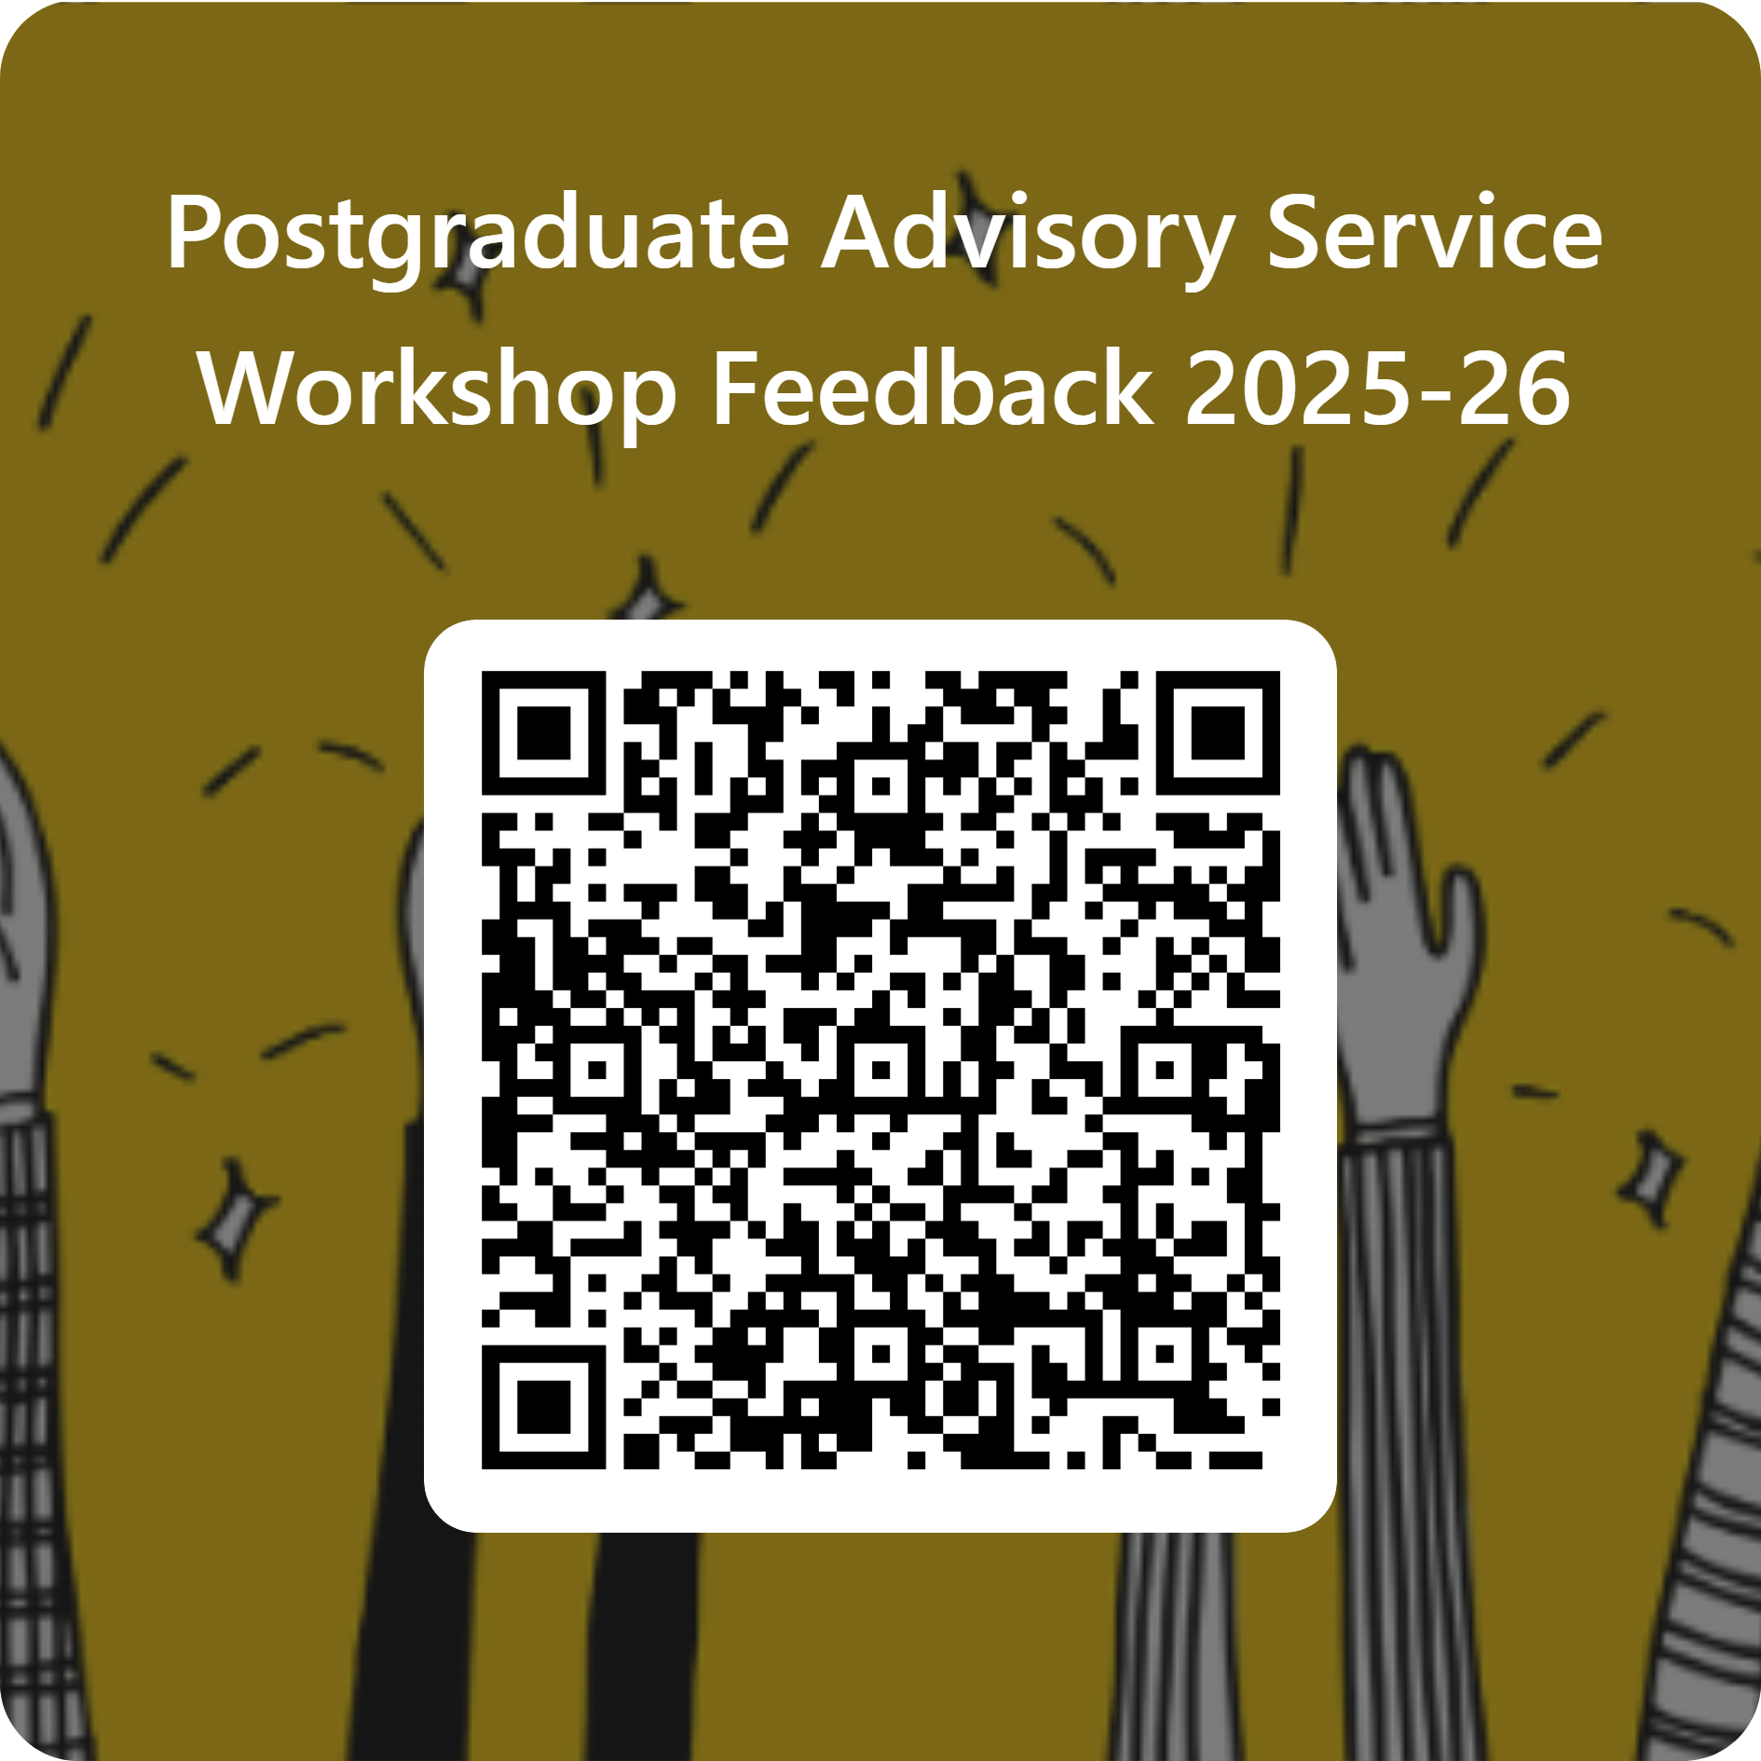
Give us feedback on this session, please!
Scan the QR code to fill in our 2-minute feedback survey
Responses are anonymous; no identifying information is requested.

